Slide 1
CLUSTERING
IN
MACHINE LEARNING

Slide 2
Introduction
Have you come across a situation when a Chief Marketing Officer of a company tells you – “Help me understand our customers better so that we can market our products to them in a better manner!”
Or
Election department has data of election and wants to analyse its data.
Or
ICC has data of many matches and wants to analyse its data.

Slide 3
Introduction
In all these case analysts was completely clueless what to do!
As we have studied supervised machine learning and we know that what to find out.
But I had no clue what to do in this case or we don’t know what is the target.

Slide 4
Introduction
This is usually the first reaction when you come across an unsupervised learning problem for the first time!
You are not looking for specific insights for a phenomena, but what you are looking for are structures with in data without them being tied down to a specific outcome.

Slide 5
Clustering
The method of identifying similar groups of data in a dataset is called clustering. It is one of the most popular techniques in data science.
Entities in each group are comparatively more similar to entities of that group than those of the other groups.
Clustering can be easily understand by the given picture-

Slide 6

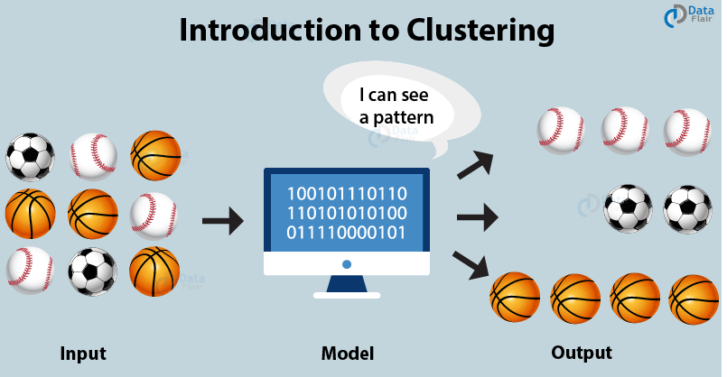
NIELIT

Slide 7
Clustering
The basic principle behind cluster is the assignment of a given set of observations into subgroups or clusters such that observations present in the same cluster possess a degree of similarity.
It is the implementation of the human cognitive ability to discern objects based on their nature.

Slide 8
Clustering
Example1-
when you go out for grocery shopping, you easily distinguish between apples and oranges in a given set containing both of them.
You distinguish these two objects based on their colour, texture and other sensory information that is processed by your brain.
Clustering is an emulation of this process so that machines are able to distinguish between different objects.

Slide 9
Clustering
Example2-
Let’s understand with another example. Suppose, you are the head of a rental store and wish to understand preferences of your costumers to scale up your business.
Is it possible for you to look at details of each costumer and devise a unique business strategy for each one of them?
Definitely not. But, what you can do is to cluster all of your costumers into say 5 groups based on their purchasing habits and use a separate strategy for costumers in each of these 5 groups. And this is what we call clustering.

Slide 10
Clustering
It is a method of unsupervised learning since there is no external label attached to the object.
The machine has to learn the features and patterns all by itself without any given input-output mapping.
The algorithm is able to extract inferences from the nature of data objects and then create distinct classes to group them appropriately.

Slide 11
Why do we use clustering in ML?
In basic terms, the objective of clustering is to find different groups within the elements in the data. To do so, clustering algorithms find the structure in the data so that elements of the same cluster (or group) are more similar to each other than to those from different clusters
Clustering is an important technique as it performs the determination of the intrinsic grouping among the unlabeled dataset.
In clustering, there are no standard criteria. All of it depends on the user and the suitable criteria that satisfy their needs and requirements.

Slide 12
Why do we use clustering in ML?
For example, to find the homogeneous groups, one can find the representatives through data reduction and describe their suitable properties.
One can also find unusual data objects for outlier detection. The algorithm then makes the assumption that constitutes what similarity of points makes valid assumptions.

Slide 13
Applications of clustering
Clustering has a large no. of applications spread across various domains. Some of the most popular applications of clustering are:
Marketing : It can be used to characterize & discover customer segments for marketing purposes.
Biology : It can be used for classification among different species of plants and animals.
Libraries : It is used in clustering different books on the basis of topics and information.
Insurance : It is used to acknowledge the customers, their policies and identifying the frauds.

Slide 14
Applications of clustering
City Planning : It is used to make groups of houses and to study their values based on their geographical locations and other factors present.
Earthquake studies : By learning the earthquake affected areas we can determine the dangerous zones.
Other applications-
    Recommendation engines
    Social network analysis
    Search result grouping
    Medical imaging
    Image segmentation
    Anomaly detection

Slide 15
clustering vs classification
Classification is the process of classifying the data with the help of class labels whereas, in clustering, there are no predefined class labels.
Classification is supervised learning, while clustering is unsupervised learning.
In Classification, algorithms like Decision trees, Bayesian classifiers are used whereas, in Clustering, algorithms like K-means, Expectation Maximization is used.
Classification has prior knowledge of classes but the cluster doesn't have any prior knowledge of classes.

Slide 16
clustering vs classification
Mostly, clustering deals with unsupervised data; thus, unlabeled whereas classification works with supervised data; thus, labeled. This is one of the major reasons why clustering does not need training sets while classification does.
Clustering seeks to verify how data are similar or dissimilar among each other while classification focuses on determining data’s “classes” or groups. This makes the clustering process more focused on boundary conditions and the classification analysis more complicated in the sense that it involves more stages.

Slide 17
clustering vs classification
Example of classification: classification between gender, images.
Example of a cluster: discovery of patterns, grouping.

Slide 18
Types of Clustering
Broadly speaking, clustering can be divided into two subgroups :
Hard Clustering: In hard clustering, each data point either belongs to a cluster completely or not. For example, each customer is put into one group out of the 10 groups.
Soft Clustering: In soft clustering, instead of putting each data point into a separate cluster, a probability or likelihood of that data point to be in those clusters is assigned. For example, from the above scenario each costumer is assigned a probability to be in either of 10 clusters of the retail store.

Slide 19
Types of Clustering Algorithms
In total, there are five distinct types of clustering algorithms. They are as follows –
    Partitioning Based Clustering
    Hierarchical Clustering
    Model-Based Clustering
    Density-Based Clustering
    Fuzzy Clustering

Slide 20
Partitioning/ Centroid-based Clustering
In this type of clustering, the algorithm subdivides the data into a subset of k groups.
These k groups or clusters are to be pre-defined. It divides the data into clusters by satisfying these two requirements –
  Firstly, Each group should consist of at least one point.
  Secondly, each point must belong to exactly one group. K-Means Clustering is the most popular type of partitioning clustering method.

Slide 21
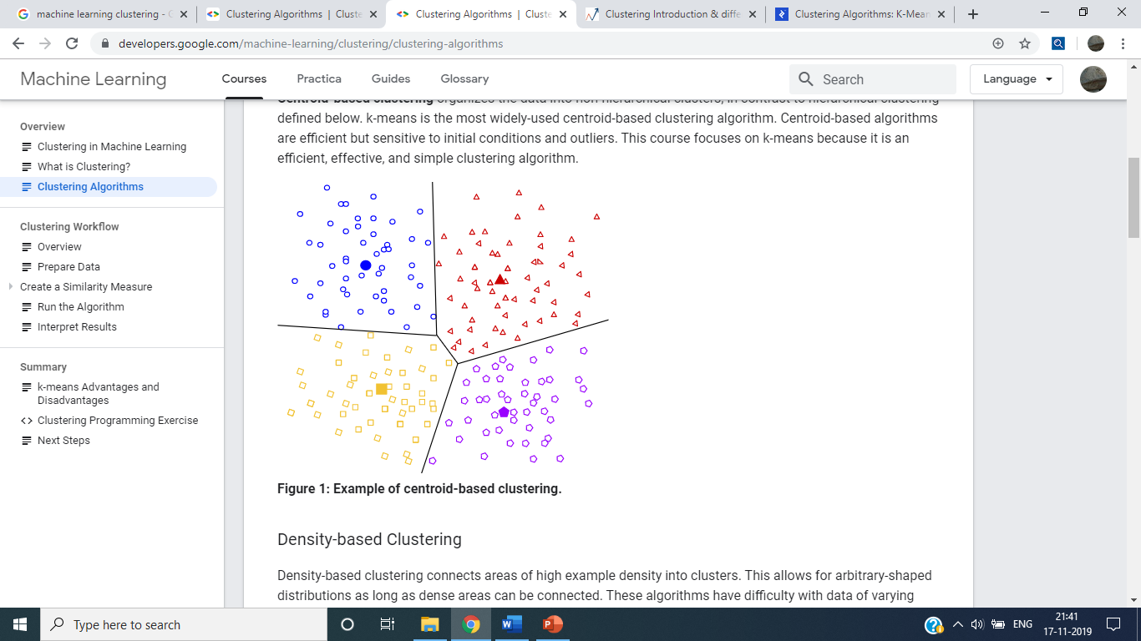
Partitioning/ Centroid-based Clustering

Slide 22
Hierarchical Clustering
The basic notion behind this type of clustering is to create a hierarchy of clusters.
As opposed to Partitioning Clustering, it does not require pre-definition of clusters upon which the model is to be built.
There are two ways to perform Hierarchical Clustering.
The first approach is a bottom-up approach, also known as Agglomerative Approach and the second approach is the Divisive Approach which moves hierarchy of clusters in a top-down approach. As a result of this type of clustering, we obtain a tree-like representation known as a dendogram.

Slide 23
Hierarchical Clustering
animal
vertebrate
invertebrate
fish reptile amphib. mammal worm insect crustacean

Slide 24
Density-Based Models
In these type of clusters, there are dense areas present in the data space that are separated from each other by sparser areas.
These type of clustering algorithms play a crucial role in evaluating and finding non-linear shape structures based on density.
The most popular density-based algorithm is DBSCAn which allows spatial clustering of data with noise.
It makes use of two concepts – Data Reachability and Data Connectivity.

Slide 25
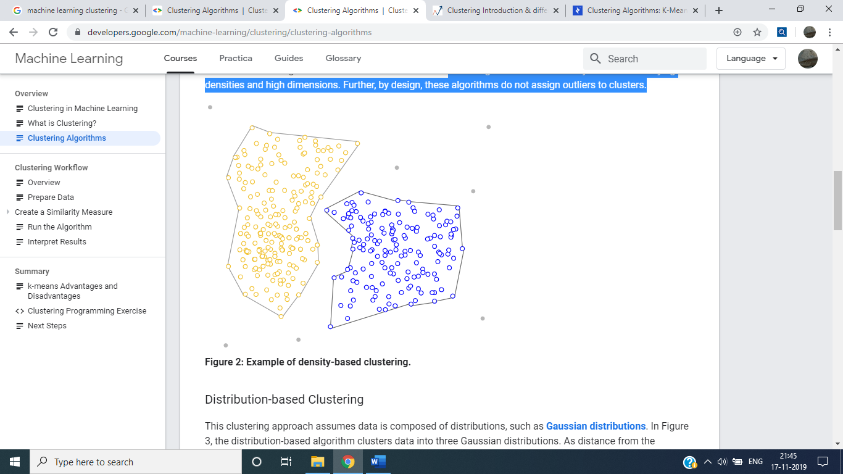
Density-Based Models
These algorithms have difficulty with data of varying densities and high dimensions. Further, by design, these algorithms do not assign outliers to clusters.

Slide 26
Model-Based Clustering
In this type of clustering technique, the data observed arises from a distribution consisting of a mixture of two or more cluster components.
Furthermore, each component cluster has a density function having an associated probability or weight in this mixture.

Slide 27
Fuzzy Clustering
In this type of clustering, the data points can belong to more than one cluster.
Each component present in the cluster has a membership coefficient that corresponds to a degree of being present in that cluster.
Fuzzy Clustering method is also known as a soft method of clustering.

Slide 28
What Is A Good Clustering?
Sec. 16.3
A good clustering will produce high quality clusters in which:
  The intra-class (that is, intra-cluster) similarity is high
  The inter-class similarity is low
  The measured quality of a clustering depends on both the document representation and the similarity measure used

Slide 29
K-Means
Program Customer Segments

Slide 30
K-Means
As the name itself suggests, this algorithm will regroup n data points into K number of clusters.
So given a large amount of data, we need to cluster this data into K clusters.
Our goal is to categorise the customers to prepare better strategy.
We don’t know how many types of customers are present in the dataset ( like rich, poor, who loves shopping, who doesn’t love shopping etc).

Slide 31
We don’t know exactly how many number of clusters that need to chosen
Let’s assume for a moment that we are going to segment our data into 3 clusters (or may be 5 cluster).
Some of the mathematical terms involved in K-means clustering are centroids, euclidian distance.
On a quick note centroid of a data is the average or mean of the data.

Slide 32

Euclidian distance is the distance between two points in the coordinate plane. Given two points A(x1,y1) and B(x2,y2), the euclidian distance between these two points is :
We can use other method also to measure the distance.

Slide 33
Algorithm:
Now let’s start talking about the implementation steps. We shall be using either cluster centers or centroids words to describe the cluster centers.

Slide 34
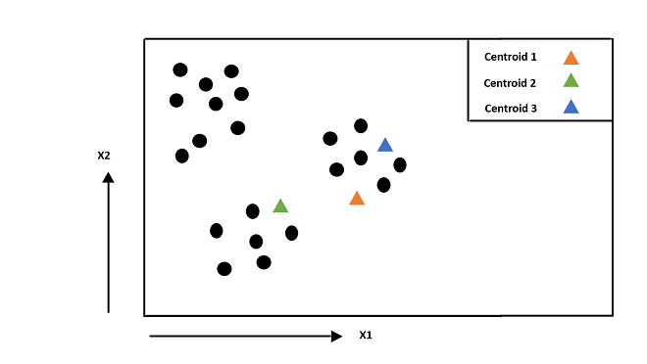
Step 1:
Randomly initialize the cluster centers of each cluster from the data points.
Let’s assume K=3, so we choose randomly 3 data points and assume them as centroids.
Random Initialization of Centroids

Slide 35
Here three cluster centres or centroids with the green, orange, and blue triangle markers are chosen randomly.
Step 2:
2a.
For each data point, compute the euclidian distance from all the centroids (3 in this case) and assign the cluster based on the minimal distance to all the centroids.
In our example, we need to take each black dot, compute its euclidian distance from all the centroids (green, orange and blue), and finally color the black dot to the color of the closest centroid.

Slide 36
2b.
Adjust the centroid of each cluster by taking the average of all the data points which belong to that cluster on the basis of the computations performed in step 2a.
In our example, as we have assigned all the data points to one of the clusters, we need to calculate the mean of all the individual clusters and move the centroid to calculated mean.
Repeat this process till clusters are well separated or convergence is achieved.

Slide 37
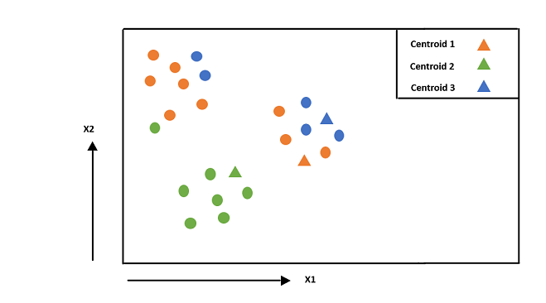
2.a Assign the centroids to each data point based on computed euclidian distances

Slide 38
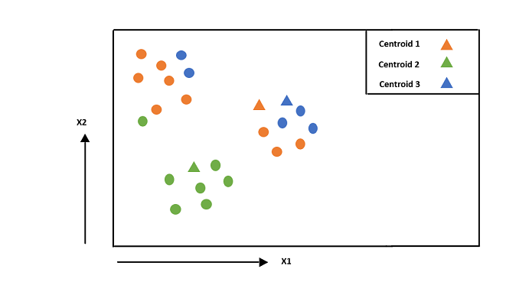
2b. Adjust the centroids by taking the average of all data points which belong to that cluster

Slide 39
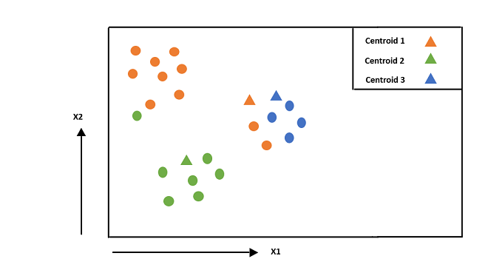
Repeat these steps until convergence is achieved:
Step 2.a

Slide 40
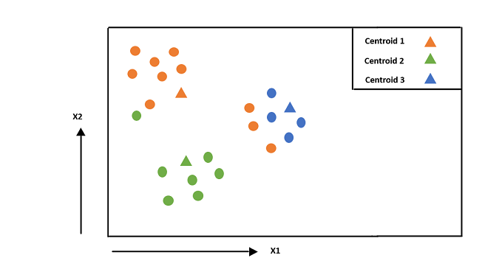
Step 2.b
Step 2.b

Slide 41
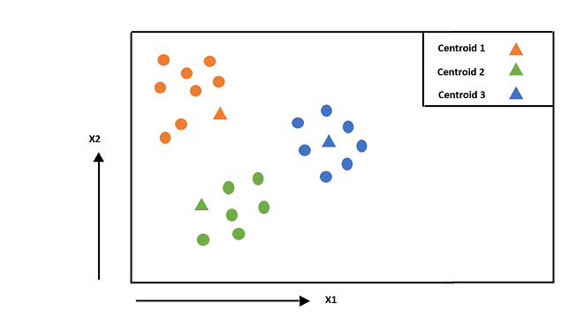
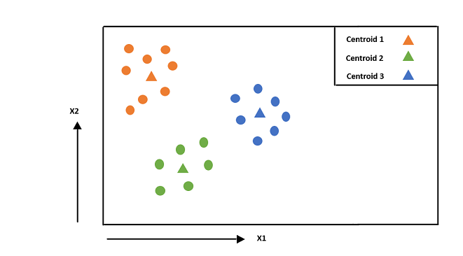
Step 2.a
Step 2.b

Slide 42
Implementation of algorithm:
We need numpy, pandas and matplotlib libraries to improve the computational complexity and visualization of the results. The dataset which we are going to use is ‘Mall_Customers.csv’

